Slide 1

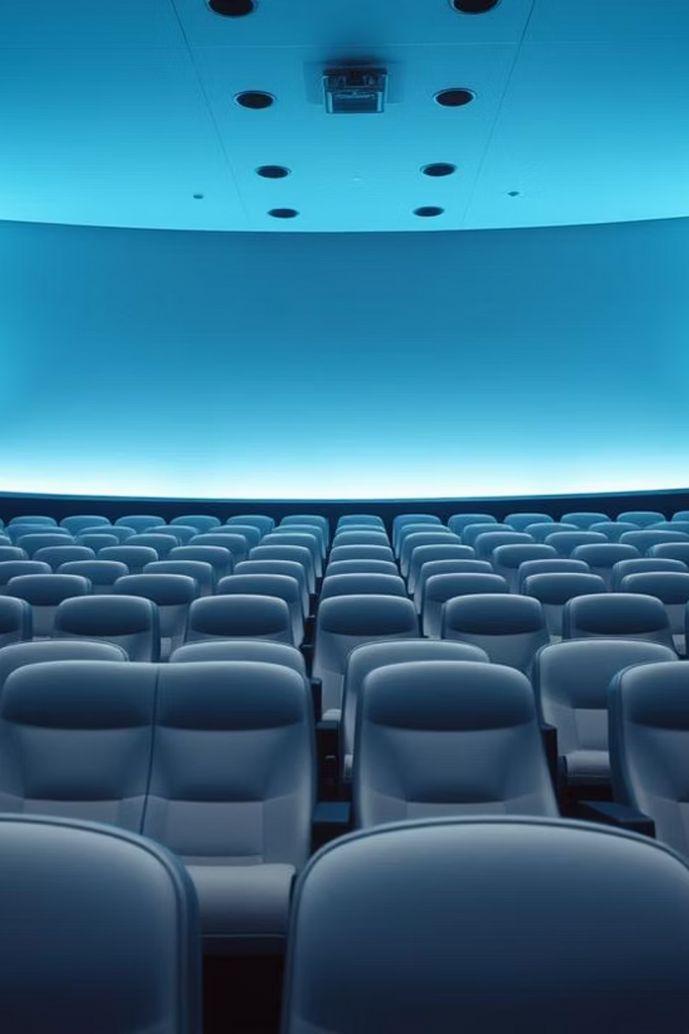
Movie Ticket Booking System
A desktop-based movie ticket booking application built with Python and PyQt5, featuring a graphical user interface for both users and administrators with modern styling and comprehensive functionality.
Notes:
1

Slide 2
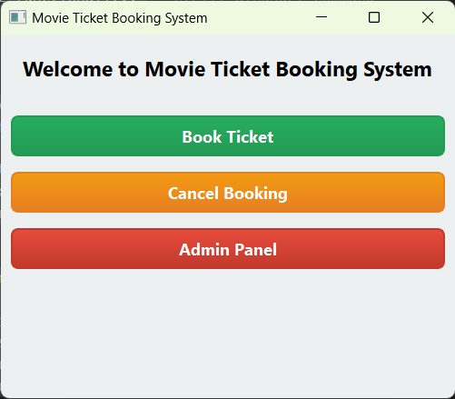
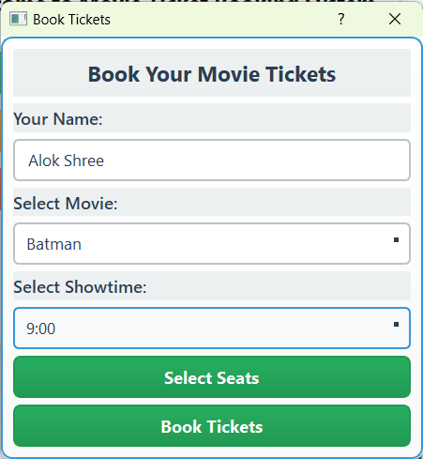
Main Window
Book Ticket

Slide 3
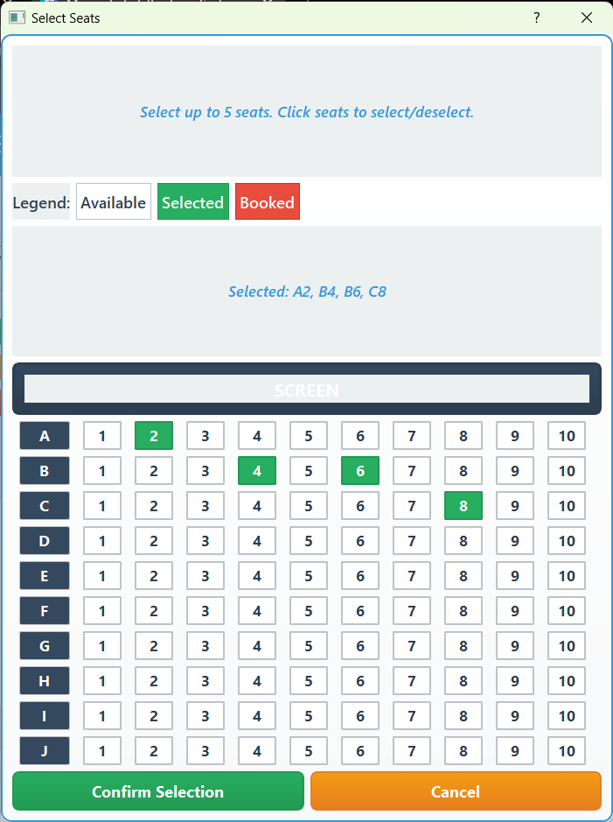
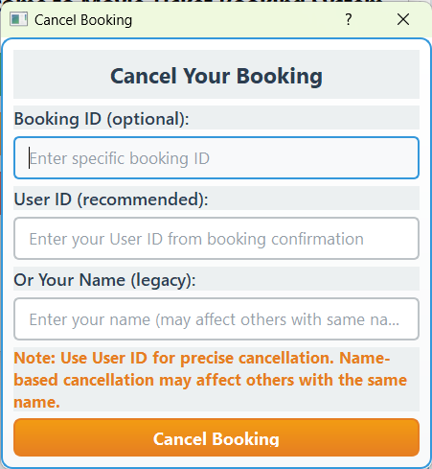
Cancel Ticket
Select Seats

Slide 4
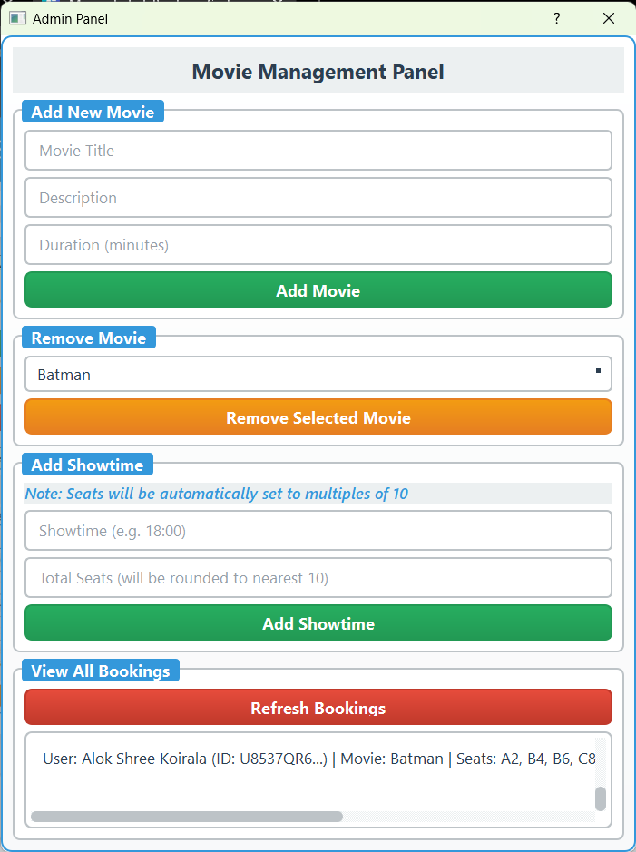
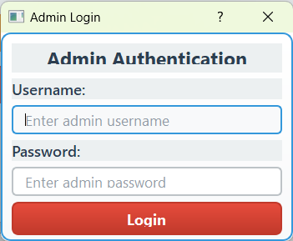
Admin Password Authenticator
Admin Panel

Slide 5




User Experience: Seamless Booking
Browse & Select
Graphical Seat Map
View available movies, descriptions, and durations. Choose preferred showtimes easily.
Interactive seat selection for up to 5 seats. Real-time updates.
Book & Cancel
Modern UI
Reserve multiple seats in a single booking. Cancel existing bookings by ID or name.
Beautiful, responsive interface with custom styling and visual feedback.
Notes:
2

Slide 6




Admin Tools: Full Control
Secure Login
Movie Management
Protected admin access with hardcoded credentials.
Add new movies with details; remove outdated entries.
Showtime Setup
Booking & Data
Add showtimes with automatic seat allocation (multiples of 10).
View all current bookings. Tools for data regeneration and maintenance.
Notes:
3

Slide 7
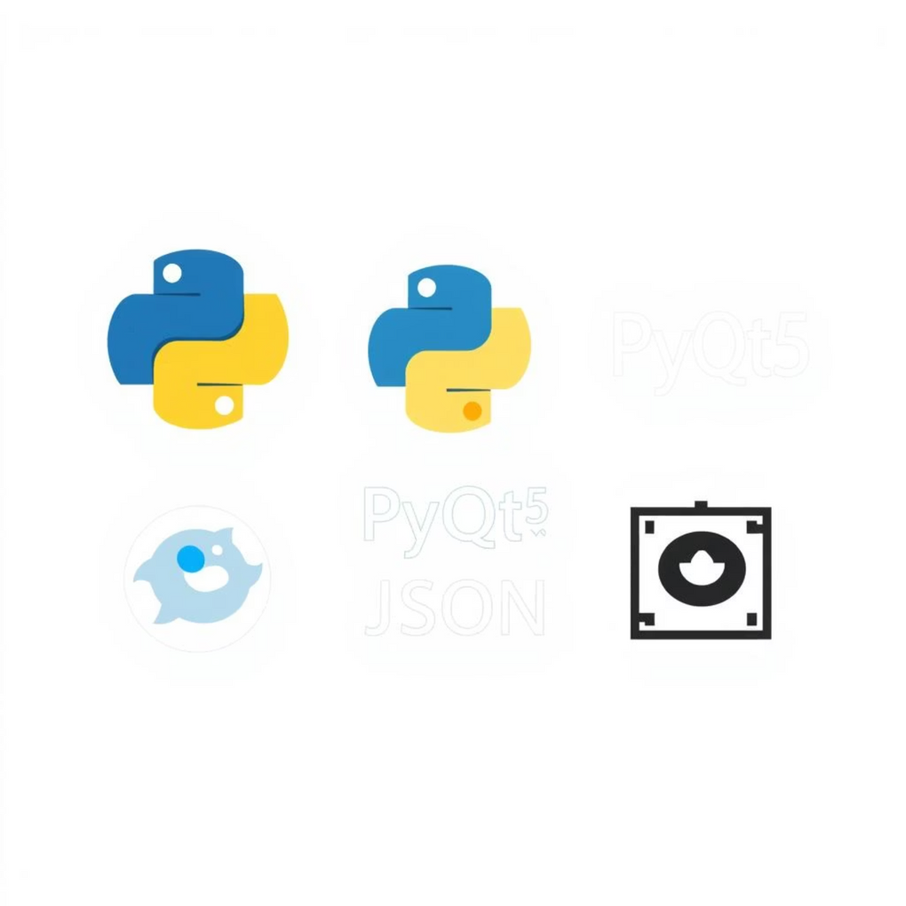
Technical Foundations
Core Technologies
Language: Python 3.10 and above
GUI Framework: PyQt5
Data Storage: JSON files (movies.json, bookings.json)
Modular design, custom QSS styling for modern appearance, and an efficient seat allocation system.
Notes:
4

Slide 8




Booking Process: User Flow
1. Initiate Booking
2. Choose Movie/Showtime
Click "Book Ticket" and enter your name.
Select from dropdowns.
3. Select Seats
4. Confirm & Book
Graphical map, up to 5 seats.
Review and complete the booking.
Notes:
6

